Slide 1
SQL SUBQUERY

Slide 2
When to use Subquery?
A Subquery or Inner query or a Nested query is a query within another SQL query and embedded within the WHERE clause.
A subquery is used to return data that will be used in the main query as a condition to further restrict the data to be retrieved.
Subqueries can be used with the SELECT, INSERT, UPDATE, and DELETE statements along with the operators like =, <, >, >=, <=, IN, BETWEEN, etc.

Slide 3
There are a few rules that subqueries must follow −
Subqueries must be enclosed within parentheses.
A subquery can have only one column in the SELECT clause, unless multiple columns are in the main query for the subquery to compare its selected columns.
An ORDER BY command cannot be used in a subquery, although the main query can use an ORDER BY. The GROUP BY command can be used to perform the same function as the ORDER BY in a subquery.
Subqueries that return more than one row can only be used with multiple value operators such as the IN operator.
A subquery cannot be immediately enclosed in a set function.
The BETWEEN operator cannot be used with a subquery. However, the BETWEEN operator can be used within the subquery.

Slide 4
Subqueries with the SELECT Statement
Subqueries are most frequently used with the SELECT statement.
Syntax:
SELECT column_name [, column_name ] FROM table1 [, table2 ]
WHERE column_name OPERATOR
(SELECT column_name [, column_name] FROM table1 [, table2 ] [WHERE]);

Slide 5
EXAMPLE:
SELECT * FROM CUSTOMERS WHERE ID IN (SELECT ID FROM CUSTOMERS
WHERE SALARY > 4500) ;

Slide 6
Subqueries with the INSERT Statement
Subqueries also can be used with INSERT statements.
The INSERT statement uses the data returned from the subquery to insert into another table.
The selected data in the subquery can be modified with any of the character, date or number functions.
Syntax:
INSERT INTO table_name [ (column1 [, column2 ]) ]
SELECT [ *|column1 [, column2 ] FROM
table1 [, table2 ]
[ WHERE VALUE OPERATOR ]

Slide 7
EXAMPLE:
INSERT INTO CUSTOMERS_BKP
SELECT * FROM CUSTOMERS WHERE ID IN (SELECT ID FROM CUSTOMERS) ;

Slide 8
Subqueries with the UPDATE Statement
The subquery can be used in conjunction with the UPDATE statement.
Either single or multiple columns in a table can be updated when using a subquery with the UPDATE statement.
Syntax:
UPDATE table
SET column_name = new_value
[ WHERE OPERATOR [ VALUE ]
(SELECT COLUMN_NAME FROM TABLE_NAME) [ WHERE) ]

Slide 9
EXAMPLE:
UPDATE CUSTOMERS
SET SALARY = SALARY * 0.25
WHERE AGE IN
(SELECT AGE FROM CUSTOMERS_BKP WHERE
AGE >= 27 );

Slide 10
Subqueries with the DELETE Statement
The subquery can be used in conjunction with the DELETE statement like with any other statements mentioned above.
Syntax:
DELETE FROM TABLE_NAME
[ WHERE OPERATOR [ VALUE ]
(SELECT COLUMN_NAME FROM TABLE_NAME) [ WHERE) ]

Slide 11
EXAMPLE:
DELETE FROM CUSTOMERS
WHERE AGE IN
(SELECT AGE FROM CUSTOMERS_BKP
WHERE AGE >= 27 );

Slide 12
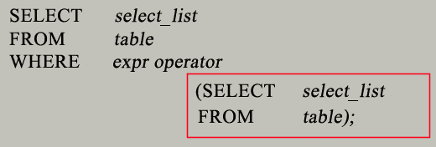
MySql SubQuery Syntax

Slide 13
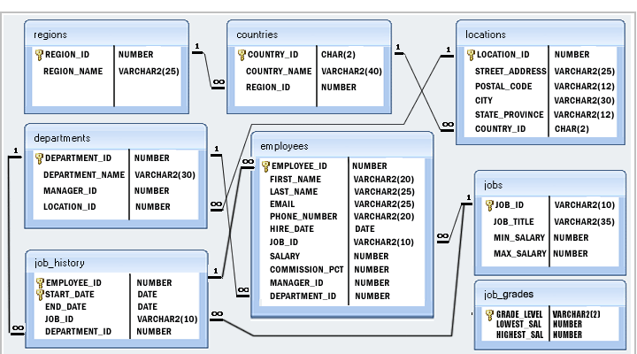
EMPLOYEE (HR) DATABASE

Slide 14
Q1. Write a query to find the name (first_name, last_name) and the salary of the employees who have a higher salary than the employee whose last_name=‘Roy’
SELECT FIRST_NAME, LAST_NAME, SALARY FROM employees WHERE SALARY >
(SELECT salary FROM employees WHERE last_name = ‘Roy');

Slide 15
Q2. Write a query to find the name (first_name, last_name), and salary of the employees whose salary is greater than the average salary
SELECT first_name, last_name, salary FROM employees WHERE salary >
(SELECT AVG(salary) FROM employees);

Slide 16
Q3. Write a query to find the name (first_name, last_name) of all employees who works in the IT department.
SELECT first_name, last_name FROM employees WHERE department_id IN
(SELECT department_id FROM departments WHERE department_name='IT');

Slide 17
Q4. Write a query to find the name (first_name, last_name) of the employees who have a manager and worked in a USA based department.
SELECT first_name, last_name FROM employees WHERE manager_id IN
(select employee_id FROM employees WHERE department_id IN
(SELECT department_id FROM departments WHERE location_id IN
(select location_id from locations where country_id='US')));

Slide 18
Q5. Write a query to find the name (first_name, last_name), and salary of the employees whose salary is equal to the minimum salary for their job grade.
SELECT first_name, last_name, salary FROM employees WHERE employees.salary =
(SELECT min_salary FROM jobs WHERE employees.job_id = jobs.job_id);

Slide 19
Q6. Write a query to find the name (first_name, last_name), and salary of the employees who earns more than the average salary and works in any of the IT departments.
SELECT first_name, last_name, salary FROM employees WHERE department_id IN
(SELECT department_id FROM departments WHERE department_name LIKE 'IT%') AND
salary >
(SELECT avg(salary) FROM employees);

Slide 20
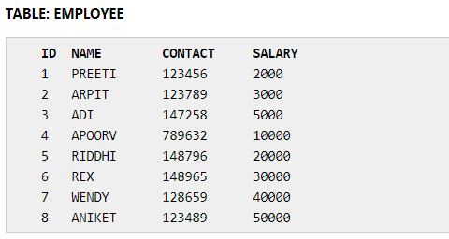
Q7A. Write a query to fetch even numbered records from employees table Where ID is given.
Case 1: Write a query to find even records in MYSQL.
SELECT * FROM EMPLOYEE WHERE id IN(SELECT id FROM EMPLOYEE WHERE id%2 = 0);
Case 2: Write a query to find odd records in MYSQL.
SELECT * FROM EMPLOYEE WHERE id IN(SELECT id FROM EMPLOYEE WHERE id%2 <> 0);

Slide 21
Q7B. Write a query to fetch even numbered records from employees table. (No ID or such is provided in the table)
SET @i = 0;
SELECT i, employee_id FROM
(SELECT @i := @i + 1 AS i, employee_id FROM employees) a
WHERE MOD(a.i, 2) = 0;

Slide 22
Q8. Write a query to find the 5th maximum salary in the employees table. [N=5]
SELECT DISTINCT salary FROM employees e1 WHERE N =
(SELECT COUNT(DISTINCT salary)
FROM employees e2 WHERE
e2.salary >= e1.salary);
Or
SELECT salary FROM Employee ORDER BY salary DESC LIMIT N-1, 1

Slide 23
-- creating Employee table in
CREATE TABLE Employee (name varchar(10), salary int);
-- inserting sample data into Employee table
INSERT INTO Employee VALUES ('Rick', 3000);
INSERT INTO Employee VALUES ('John', 4000);
INSERT INTO Employee VALUES ('Shane', 3000);
INSERT INTO Employee VALUES ('Peter', 5000);
INSERT INTO Employee VALUES ('Jackob', 7000);
Find 3rd Highest Salary: [N=3]
SYNTAX:
SELECT name, salary FROM Employee e1 WHERE N-1 =
(SELECT COUNT(DISTINCT salary) FROM Employee e2 WHERE e2.salary > e1.salary)
QUERY:
SELECT name, salary FROM Employee e1 WHERE 3-1 =
(SELECT COUNT(DISTINCT salary) FROM Employee e2 WHERE e2.salary > e1.salary)
Result:
name salary
John 4000

Slide 24
Q9. Write a query to find the 4th minimum salary in the employees table.
SELECT DISTINCT salary FROM employees e1 WHERE 4 =
(SELECT COUNT(DISTINCT salary) FROM employees e2 WHERE
e2.salary <= e1.salary);

Slide 25
Q10. Write a query to select last 10 records from a table.
SELECT * FROM
( SELECT * FROM employees ORDER BY employee_id DESC LIMIT 10)
sub ORDER BY employee_id ASC;

Slide 26
Q11. Write a query to list the department ID and name of all the departments where no employee is working.
SELECT * FROM departments WHERE department_id
NOT IN
(select department_id FROM employees);

